Slide 1
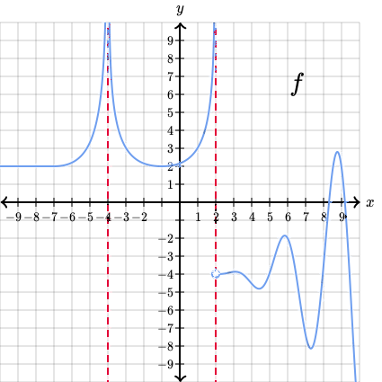
2.1 c finding limits
Graphically
& numerically
Mathgotserved.com

Slide 2
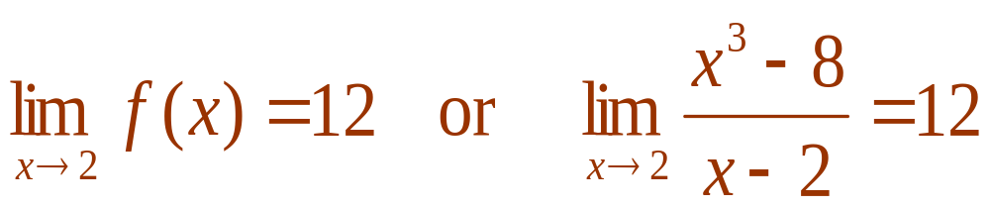
Understanding Limits Graphically
x | 1.75 | 1.9 | 1.99 | 1.999 | 2 | 2.001 | 2.01 | 2.1 | 2.25
f (x) | 10.563 | 11.41 | 11.94 | 11.994 | Und. | 12.006 | 12.06 | 12.61 | 13.56
It should be obvious that as x gets closer and closer to 2, the value of f (x) becomes closer and closer to
Formally we say that “the limit of f (x) as x approaches 2 is 12” and this is written as:
12
The informal definition of a limit is “it’s what’s happening to y as x gets close to a certain number (from both sides).”

Slide 3
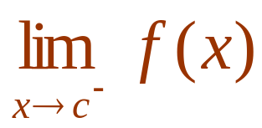
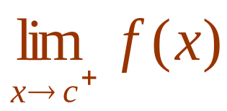
Understanding Limits Graphically
In order for a limit to exist, we must be approaching the same y-value as we approach some c from either the left or the right side.
If we are not approaching the same y-value from both the left and right side, we say that the limit Does Not Exist (DNE) as we approach c.
If we want the limit of f (x) as we approach some value of c from the left-hand side we write the left-hand limit:
If we want the limit of f (x) as we approach some value of c from the right-hand side we write the right-hand limit:

Slide 4
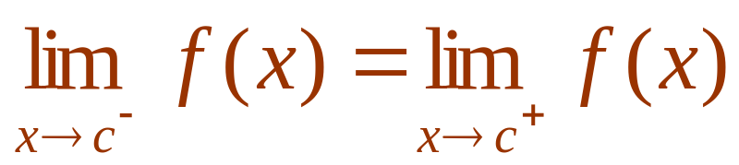
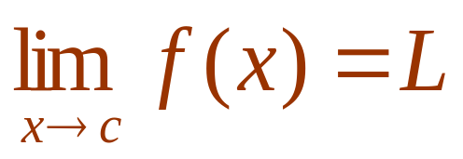
Understanding Limits Graphically
In order for a limit to exist at c, the left-hand limit must equal the right hand limit.
If the left-hand limit equals the right hand limit, then the limit exists and we write:

Slide 5
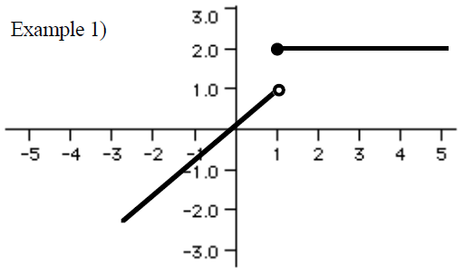
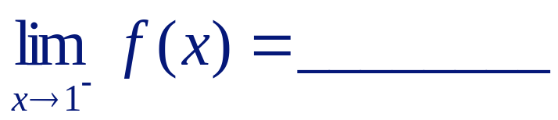
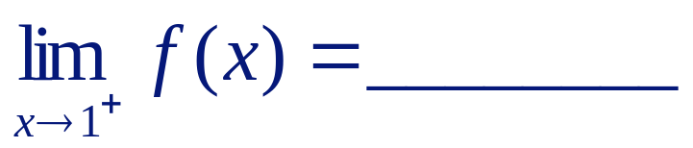
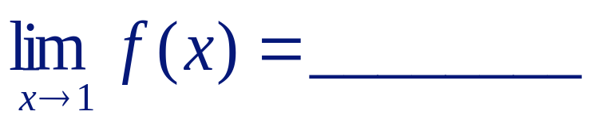
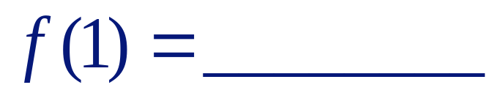
Problem 1:
Evaluate each of the following:
1
2
DNE
2

Slide 6
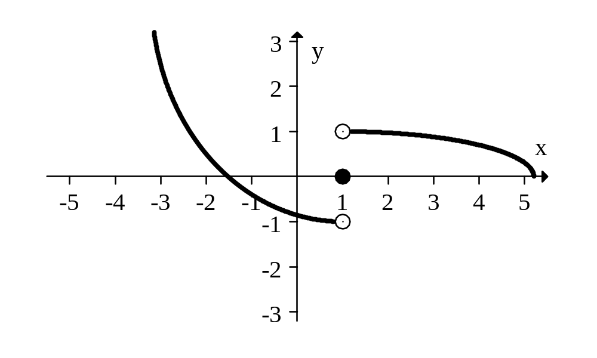
Example 2:
Evaluate each of the following:
-1
1
DNE
0

Slide 7
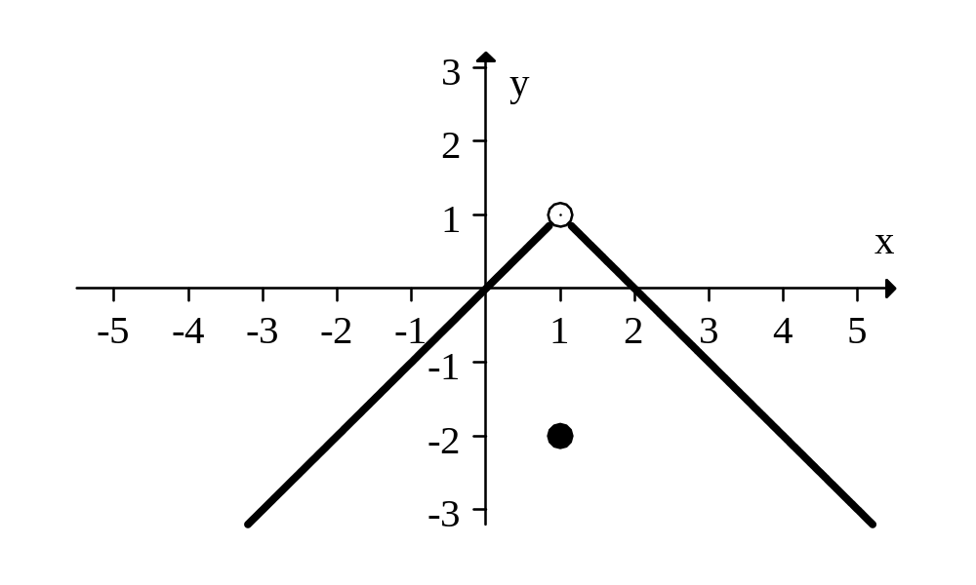
Example 3:
Evaluate each of the following:
1
1
1
-2

Slide 8
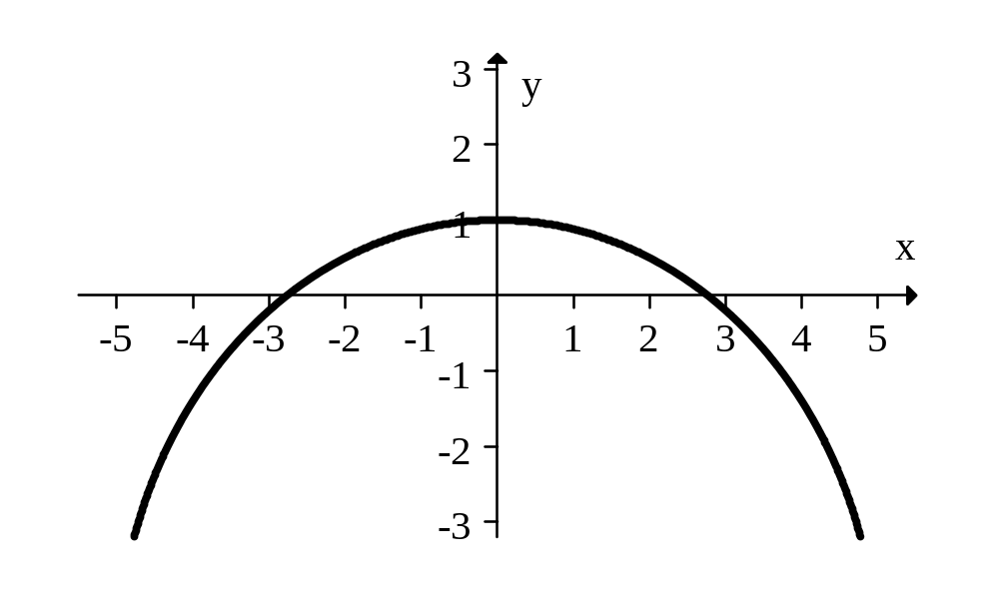
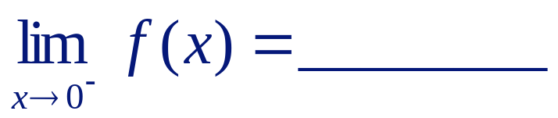
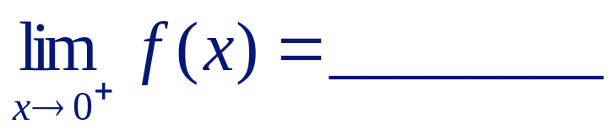
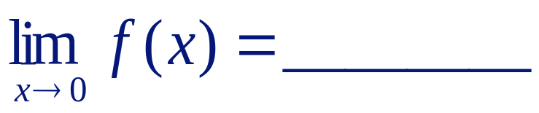
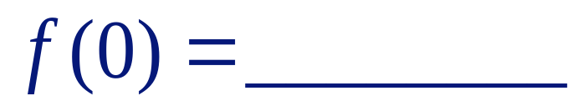
Example 4:
Evaluate each of the following:
1
1
1
1

Slide 9
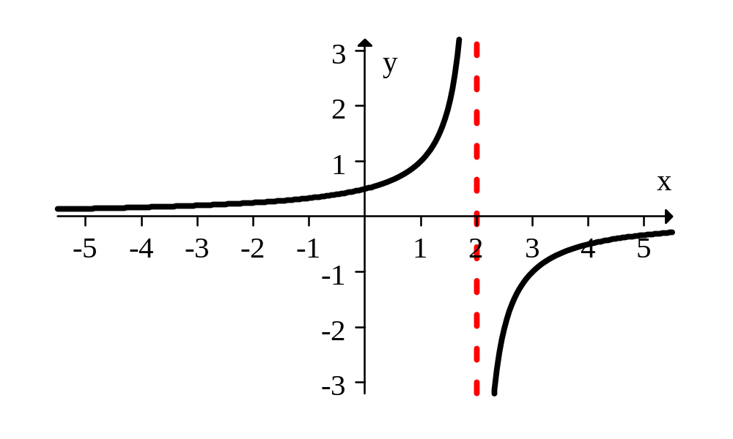
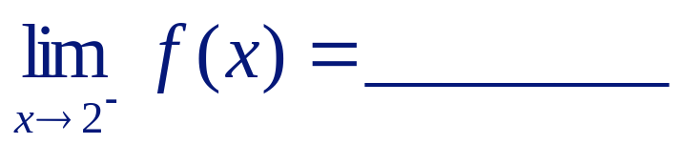


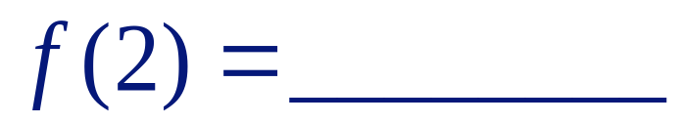
Example 5:
Evaluate each of the following:
∞
-∞
DNE
undefined

Slide 10
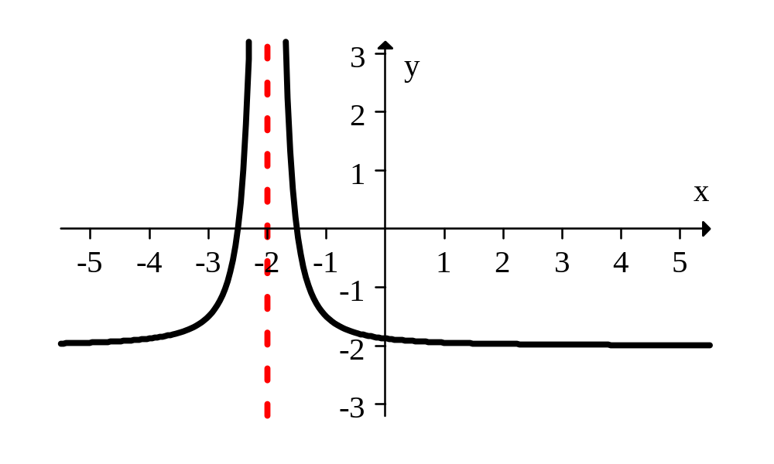
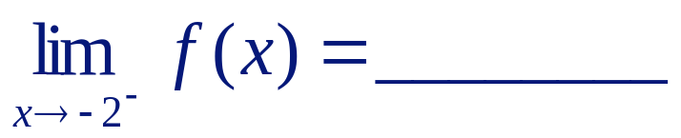


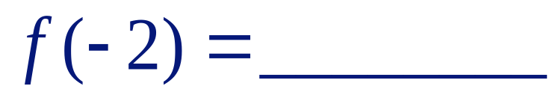
Example 6:
Evaluate each of the following:
∞
∞
∞
undefined

Slide 11
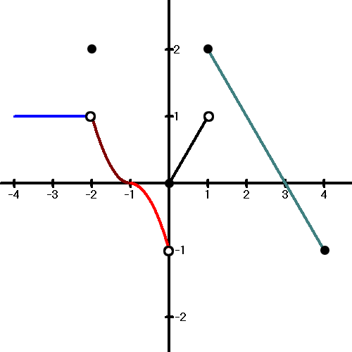

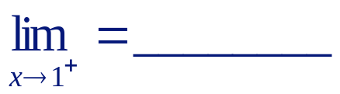


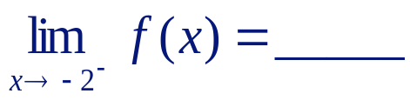
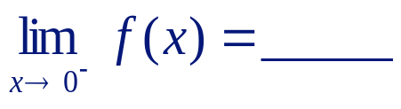
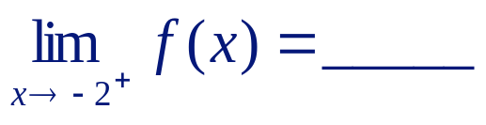
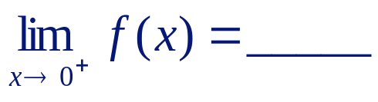
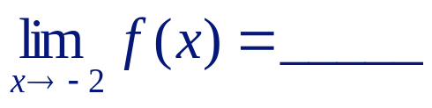
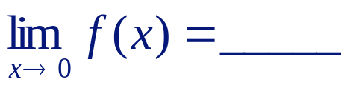


Example 7:
Evaluate each of the following:
1
2
DNE
2
1
-1
1
0
1
DNE
2
0

Slide 12
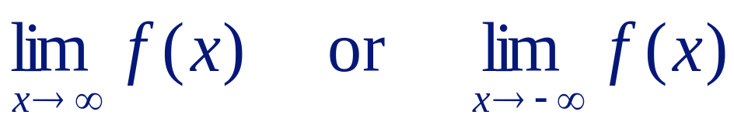
Understanding Limits Graphically
The concept of limits as x approaches infinity means the following: “it’s what happens to y as x gets infinity large.”
We are interested in what is happening to the y-value as the curve gets farther and farther to the right.
We can also talk about limits as x approaches negative infinity – which is what is happening to the y-values as the curve gets farther and farther to the left.
For limits to infinity, we use the following notation:
Although we use the term “as x approaches infinity,” realize that x cannot actually approach infinity since infinity does not actually exist. It’s just an expression to easily speak of going infinitely far to the right.

Slide 13
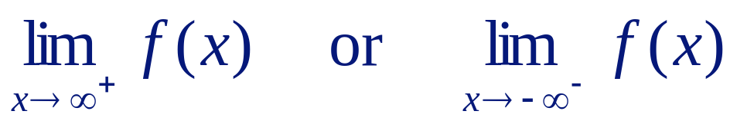
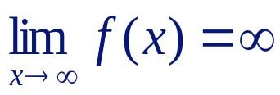
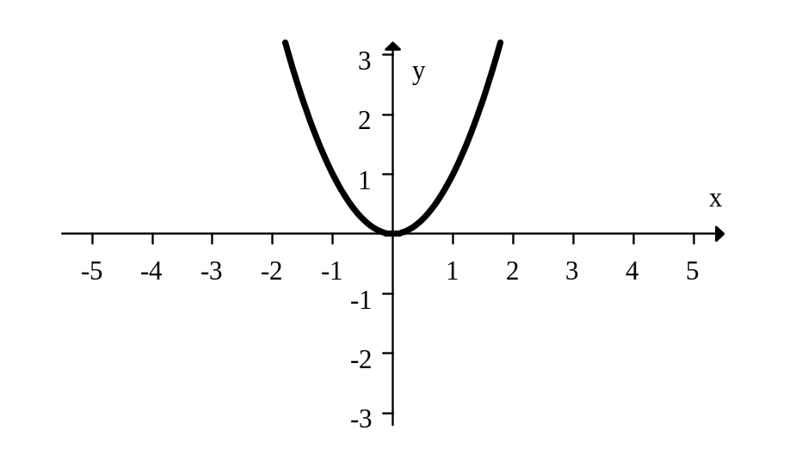
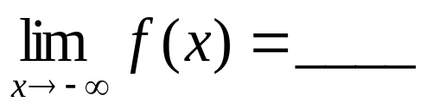
Understanding Limits Graphically
It is important to note that it makes no sense to talk about
Can you explain why this makes no sense?
There are 4 possibilities for limits to infinity:
  Possibility 1: The curve can go up forever. In this case, the limit does not exist and we write:
What is
∞

Slide 14
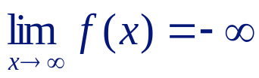
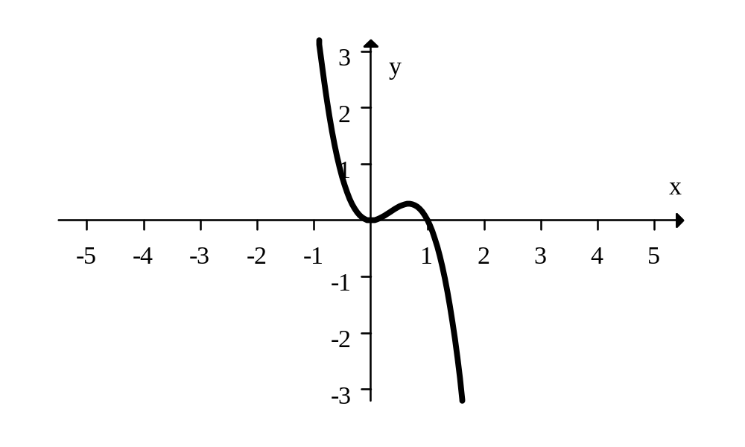
Understanding Limits Graphically
There are 4 possibilities for limits to infinity:
  Possibility 2: The curve can go down forever. In this case, the limit does not exist and we write:
What is
∞

Slide 15

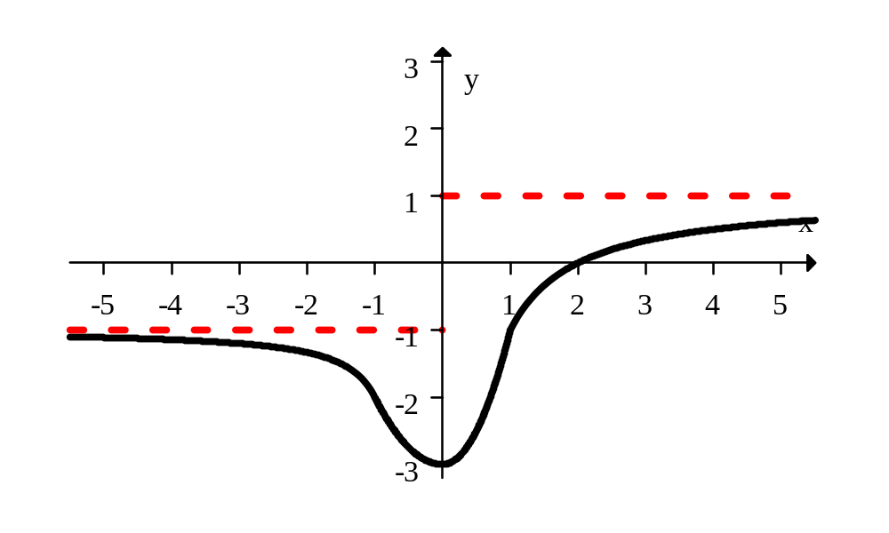
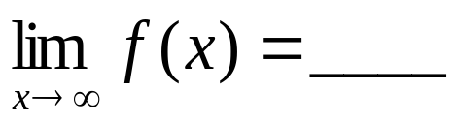
Understanding Limits Graphically
There are 4 possibilities for limits to infinity:
  Possibility 3: The curve can become asymptotic to a line. In this case, the limit as x approaches infinity is a value and we write:
What is
1
What is
-1

Slide 16
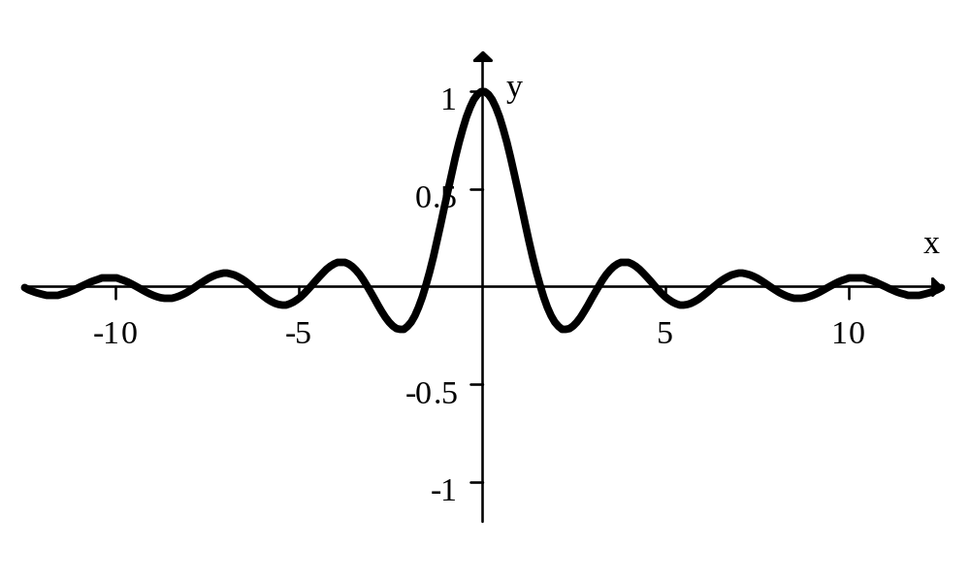
Understanding Limits Graphically
There are 4 possibilities for limits to infinity:
  Possibility 4: The curve can level off to a line. In this case, the limit as x approaches infinity is a value and we write:
What is
0
What is
0

Slide 17

FINITE LIMITS VIDEO TUTORIALS

